Slide 1
Red Card System: Streamlining QA Defect Tracking (Aaron)

Slide 2
Overview
What is the Red Card System?
Problem - Challenges with Excel-based tracking
A digital solution for efficient defect tracking and follow-up.
Manual processes cause errors, lost records, and poor defect visibility.
Solution - Microsoft Power Platform Integration
Key Features - What makes this system special
Automates defect tracking using Power Apps, Automate, SharePoint, and Power BI.
User-friendly forms, automated alerts, real-time dashboards, and complete audit trails.
Demo
User Experience - Before vs After
Live demonstration of the digital red card workflow in action.
Comparing manual, error-prone process to streamlined, digital defect management.
Remarks (Guiding: What to Pay Attention To)
Conclusion
Key usage tips and important considerations for successful system adoption.
Summarizing benefits and encouraging adoption of the new digital system.

Slide 3
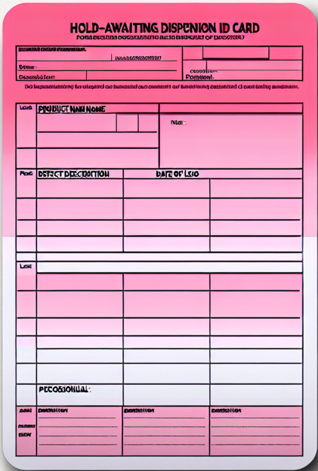





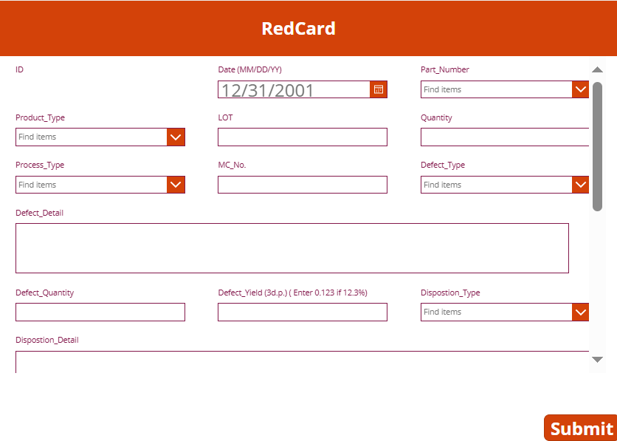
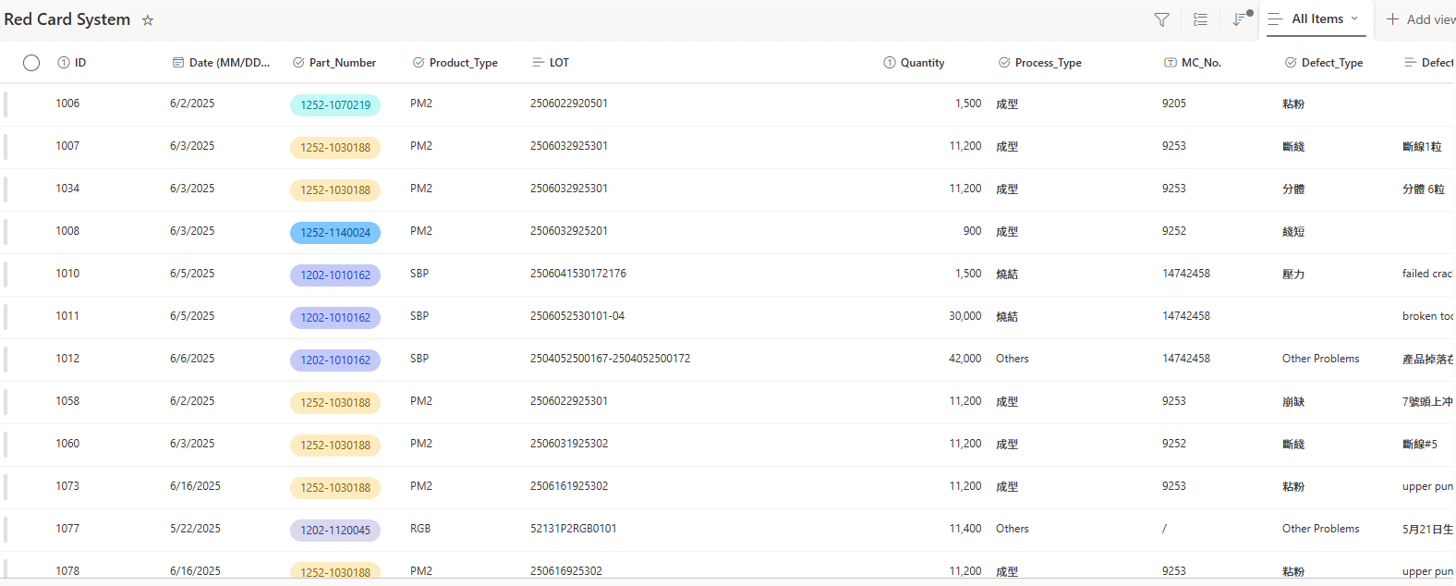
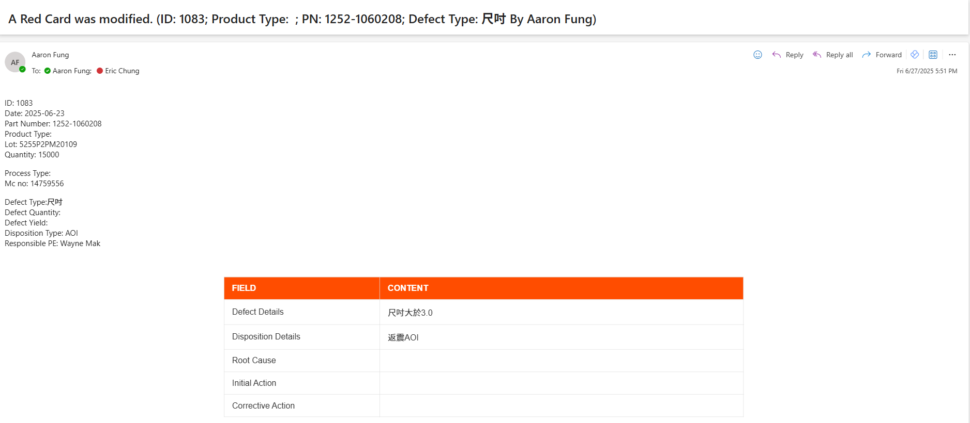
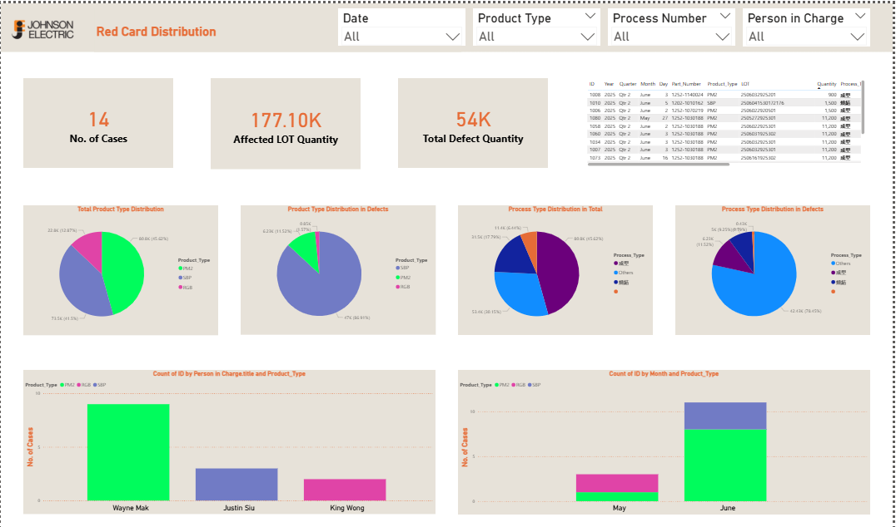
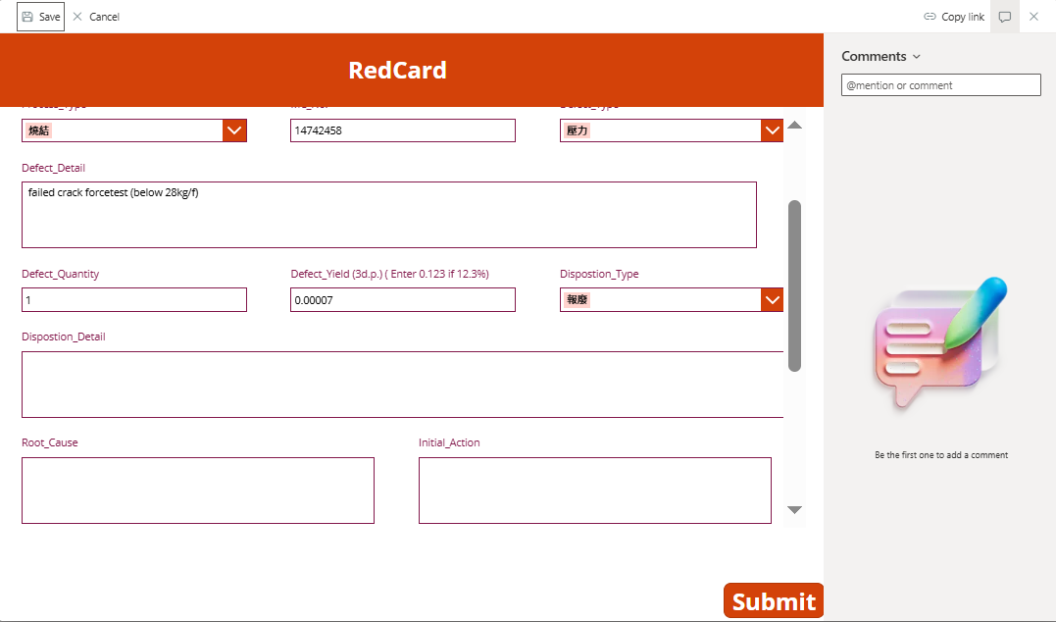
What is the Red Card System?
No. | Project Name | Objective | Result | Methodology
1 | Red Card System | - Transform manual defect tracking to digital system - Implement automated workflow notifications - Ensure data integrity and real-time visibility | - Eliminated manual data entry errors - Real-time defect status tracking - Automated engineer notifications - Enhanced data security with audit trails | - Upload data to SharePoint via Power Apps - Implement Power Automate alerts - Two-stage process: Paper → Digital → Engineers - Power BI replaces operator reporting
1️⃣ Daily operation :
Power Apps
SharePoint
Power Automate
Power BI
Multiple defect incidents occurred.
Record defects on paper red cards by Operators.
Upload data to SharePoint via Power Apps.
Automate email alerts with Power Automate.
Visualize defect trends in Power BI.
2️⃣ Engineers double checking :
Power Apps
SharePoint
Power Automate
Update forms by Engineers.
Automate email alerts with Power Automate.

Slide 4



Problem - Challenges with Excel-based tracking
Record defects on paper red cards by Operators.
Manually enter data into Excel file
Engineers manually check Excel for updates
Manual reporting and analysis
Key aspect | Description
Data Integrity & Security Issues | ❌No audit trail to track who made changes and when modifications occurred. ❌File conflicts occur when multiple people edit the same Excel file simultaneously. ❌Accidental deletions happen without any backup or recovery system in place.
Manual Process Inefficiencies | ❌Time-consuming manual data entry from paper red cards to Excel spreadsheet. ❌Human error occurs during manual data input process leading to inaccuracies. ❌No automated validation system to ensure data accuracy and completeness.
Communication & Tracking Failures | ❌No automated notifications when new defects are added or existing ones updated. ❌Lost follow-up tracking due to no systematic reminder system for engineers. ❌Engineers forget to check and update Excel regularly causing missed updates.
Reporting & Analysis Limitations | ❌Manual report creation is time-consuming and inefficient for regular analysis. ❌No updated data available for immediate decision making and monitoring. ❌Inconsistent problem descriptions make data analysis unreliable and difficult.

Slide 5







Problem – Example (No automated validation system )

Slide 6
Solution - Microsoft Power Platform Integration
Overview
Replace Excel with integrated Microsoft Power Platform for seamless defect tracking.
Key Components :
SharePoint
Power Apps
Power Automate
Power BI

Slide 7
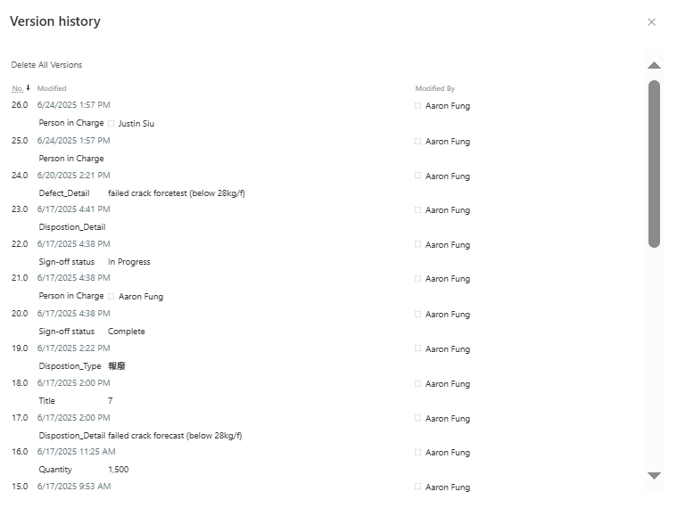
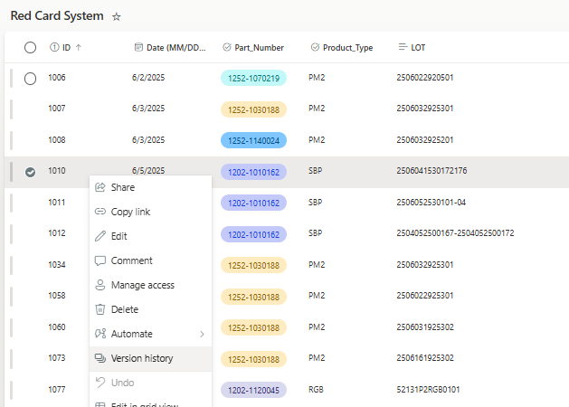
Key Features - What makes this system special
SharePoint
Version history tracking provides complete audit trail for all data changes.

Slide 8
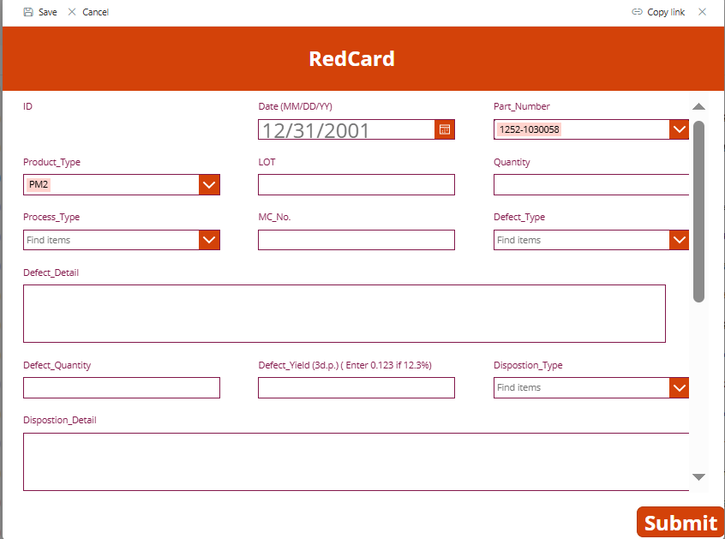
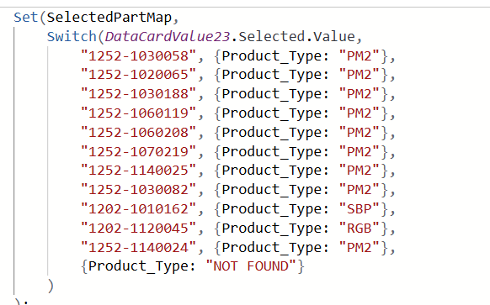
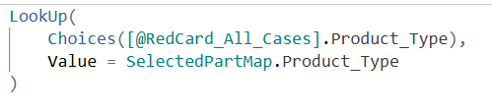
Key Features - What makes this system special
Power Apps
User-friendly, guided form ensures accurate and complete defect entry.
On Change:
DefaultSelectedItems:

Slide 9
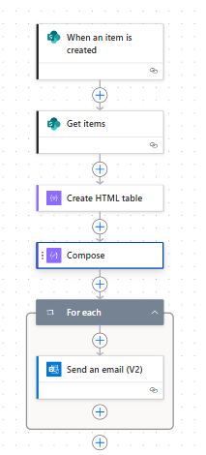
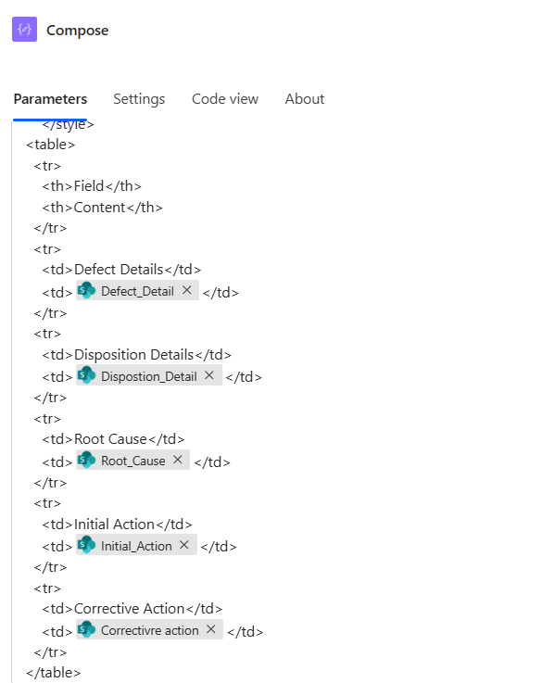
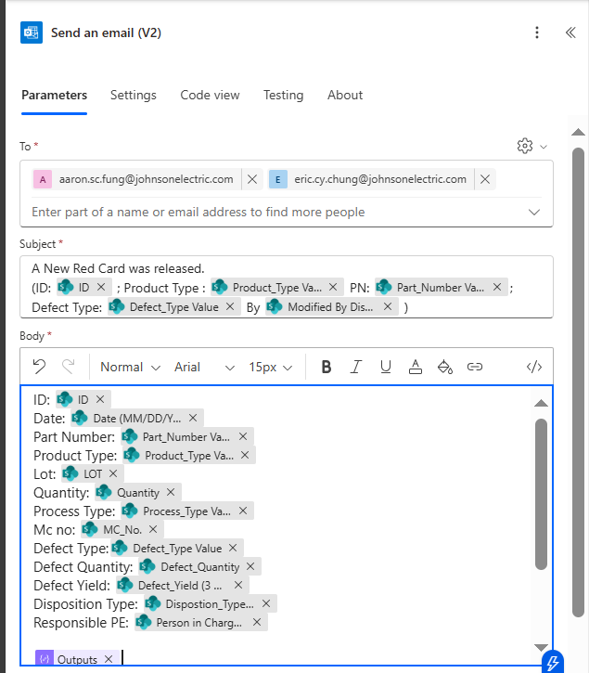
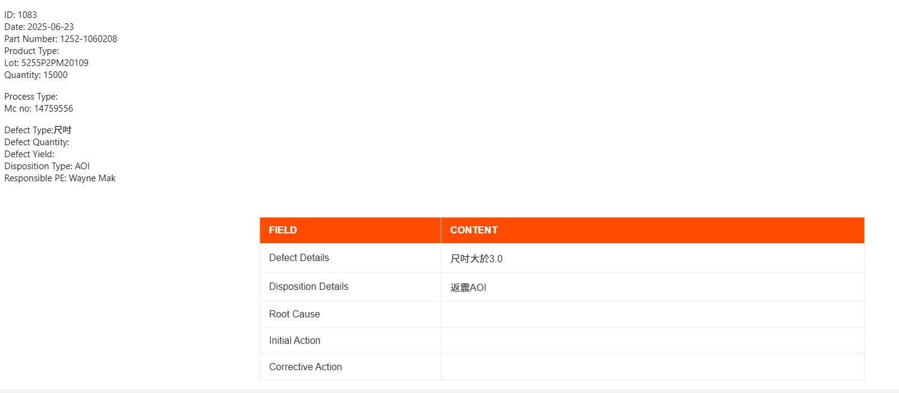
Key Features - What makes this system special
Power Automate
Automated workflows keep everyone informed and accountable.
Key Components :

Slide 10
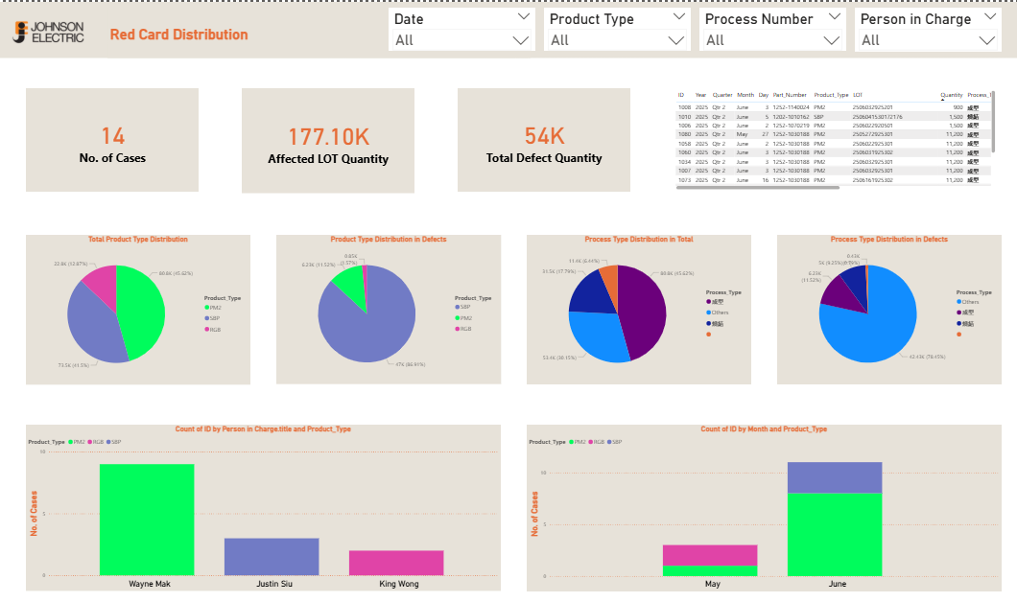
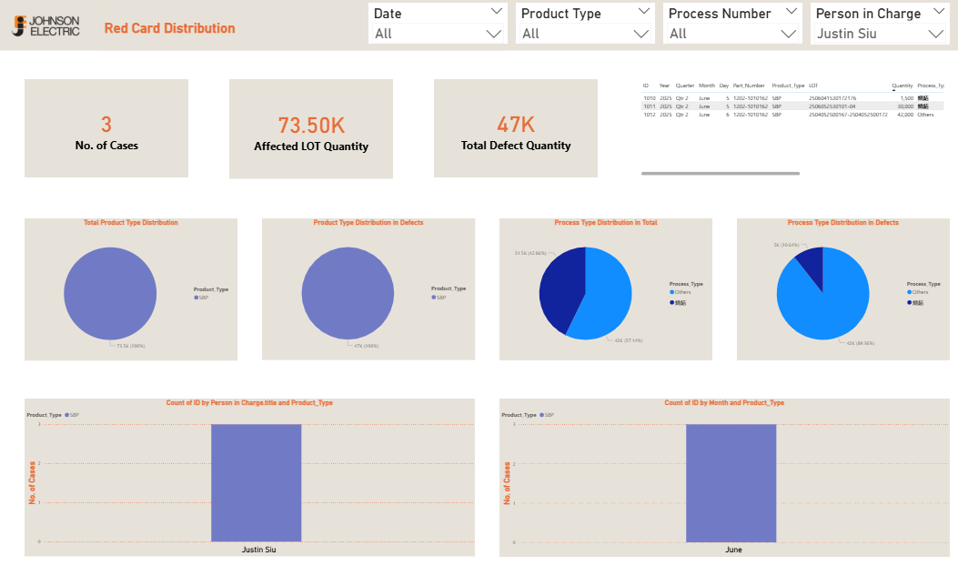
Key Features - What makes this system special
Power BI
Real-time dashboards provide actionable insights for all stakeholders.

Slide 11
Demo
1️⃣ Daily operation :
Power Apps
SharePoint
Power Automate
Power BI
Multiple defect incidents occurred.
Record defects on paper red cards by Operators.
Upload data to SharePoint via Power Apps.
Automate email alerts with Power Automate.
Visualize defect trends in Power BI.
2️⃣ Engineers double checking :
Power Apps
SharePoint
Power Automate
Update forms by Engineers.
Automate email alerts with Power Automate.

Slide 12
User Experience - Before vs After
Without Red Card System
With Red Card System
Manual data entry
Staff must retype information into Excel, increasing risk of errors and omissions.
Automated data capture
All entries are instantly saved to SharePoint
(no manual re-entry needed.)
Difficult to track
No easy way to know if a red card has been followed up or closed.
Real-time tracking
Status of every red card is visible to all stakeholders at any time.
No notifications
Engineers must remember to check for new defects; follow-ups are often missed
Automated alerts
Engineers and managers receive instant notifications for new or updated defects.

Slide 13
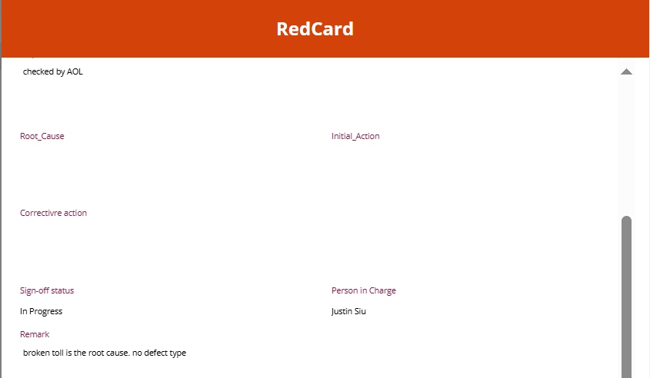
Remarks (Guiding: What to Pay Attention To)
1️⃣
2️⃣
1008

Slide 14
Conclusion
The new Red Card System transforms defect tracking from a manual, error-prone process into a streamlined, digital workflow.
Operators and engineers benefit from easier data entry, real-time notifications, and full visibility of defect status.
Automated processes and centralized records ensure nothing is missed and accountability is clear.
By leveraging Microsoft Power Platform, we enable smarter, faster, and more reliable quality management

